Slide 1
Import files multiples
Import files multiples

Slide 2
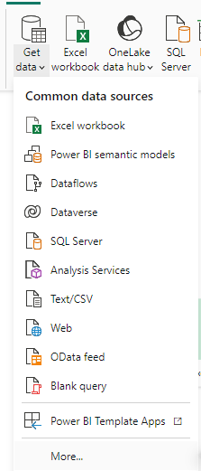
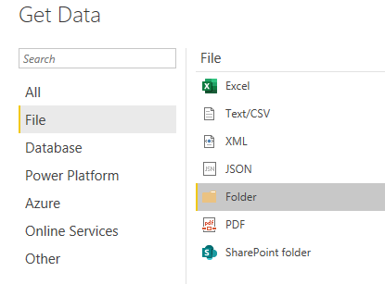
Importing from multiple files
Note: This lab uses CSV files located in \ resources \Multiple Files\Files . Choose the data source from the More... menu , then select File and then Folder .
2
3
1

Slide 3
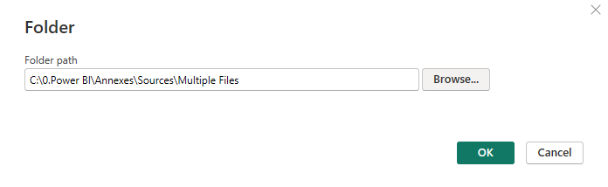
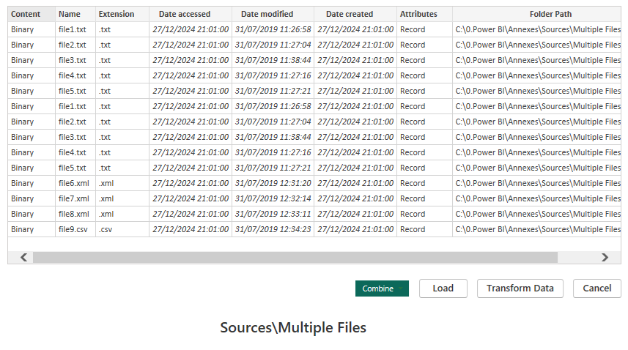

Importing from multiple files
Navigate to the Multiple Files folder located under Resources and select it.
Verify that the files represent the same structure, then choose Combine and Load .

Slide 4
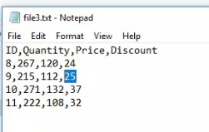
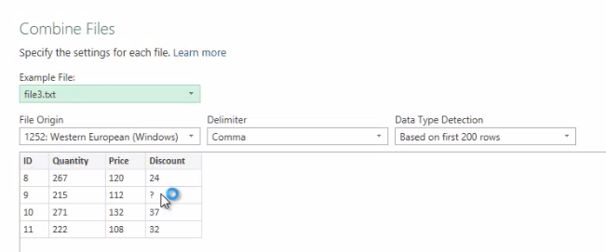
Importing from multiple files
Go back to the file3.txt on disk and edit it. Change the value 25 to a blank space or a special character to test the case where a file represents an anomaly during loading.
Notice that when loading, there is a ? instead
of the anomaly.

Slide 5
Thank you
Thank you

